Slide 1
Object Tracking

Slide 2
Objectives
What is object tracking?
The techniques used in object tracking.
What is a future of object traking?
Applications of object tracking

Slide 3
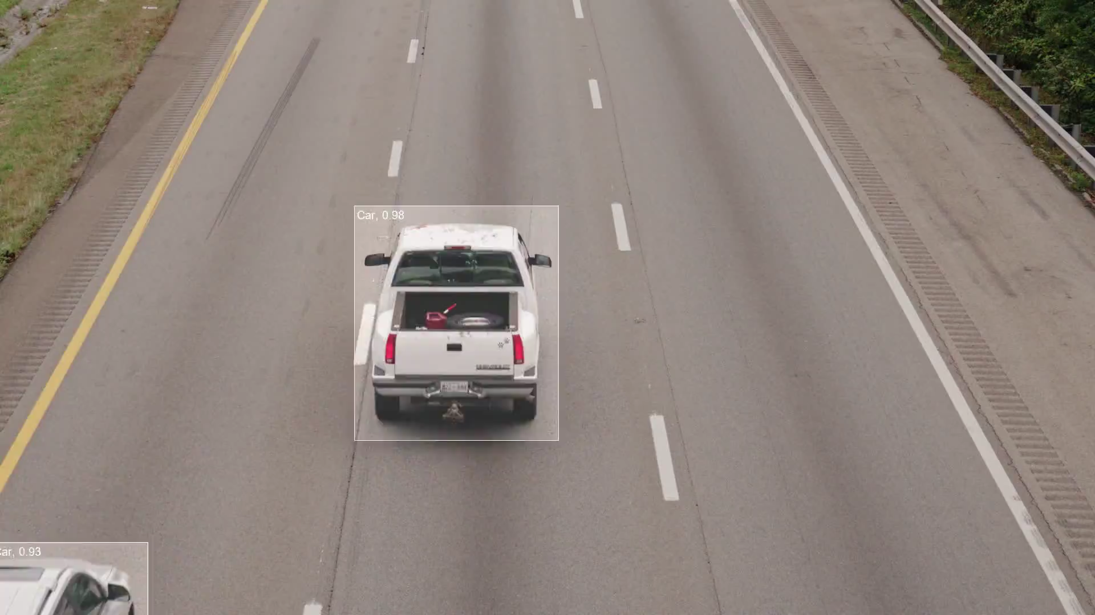
Object Tracking

Slide 4
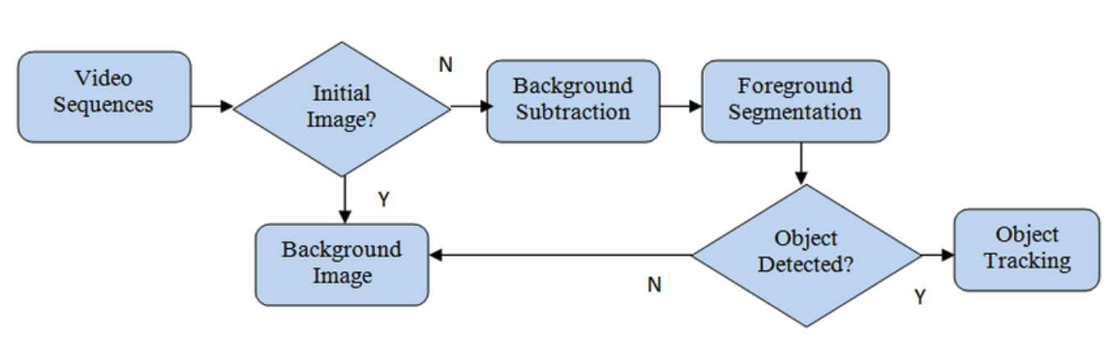
What is Object Tracking?
Object tracking is the task of taking an initial set of object detections, creating a unique ID for each of the initial detections, and then tracking each of the objects as they move around frames in a video, maintaining the ID assignment.

Slide 5
What is Object Tracking?
Frame (i)
Features (i)
Feature Extractor
Object detection
Bounding box (i+1)
Frame (i+1)
Features (i+1)
Bounding box (i)

Slide 6
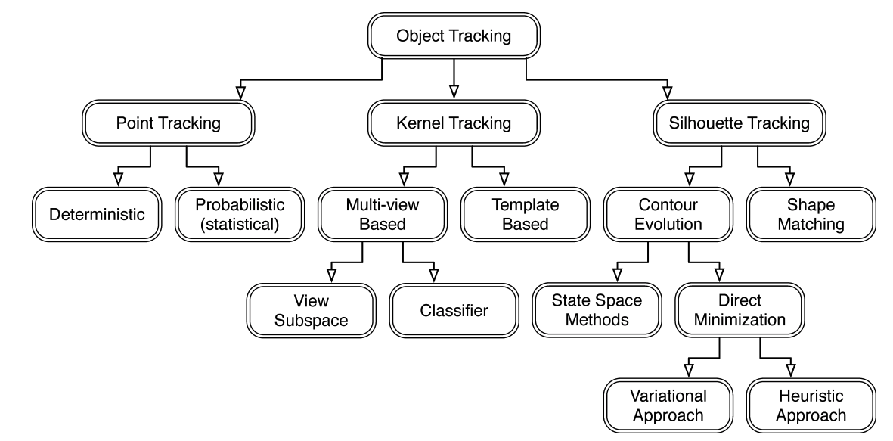
The Approach

Slide 7
The Approach
Type 1: Point Tracking: Objects detected in consecutive frames are represented by points: deterministic, probabilistic methods, and the association of the points is based on the previous object state which can include object position and motion. This approach requires an external mechanism to detect the object in every frame.

Slide 8
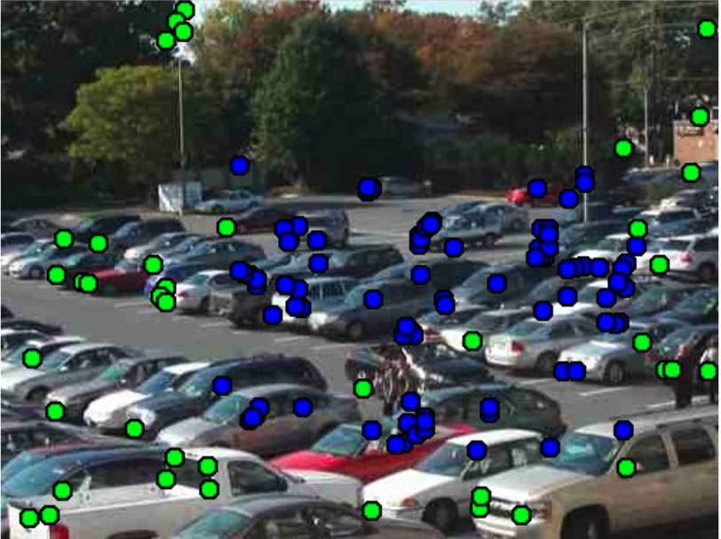
The Approach
Point Tracking: Tracked point features in an image sequence. Blue dots are older tracks and green dots are newly spawned tracks.

Slide 9
The Approach
Type 2: Kernel Tracking: kernel tracking is usually performed by locating the moving object, which is represented by an embryonic object region, from one frame to the next: multi- view based, template based. It refers to the object shape and appearance.

Slide 10
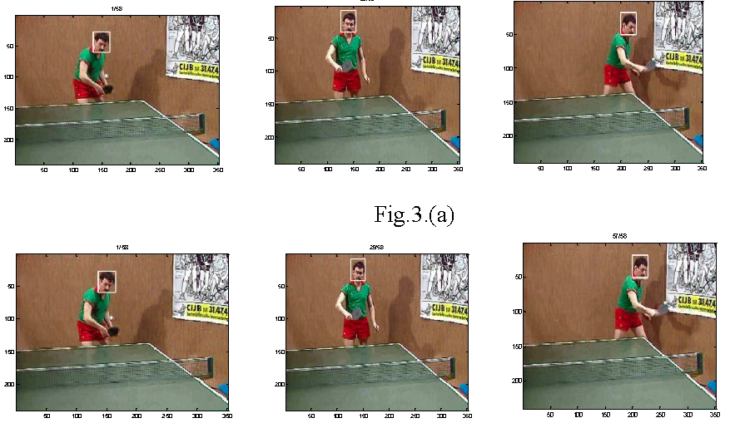
The Approach
Kernel Tracking: Kernel based Object Tracking using Colour Histogram Technique.

Slide 11
The Approach
Type 3: Silhouette Tracking: Tracking is performed by estimating the object region in each frame. Silhouette tracking methods use the information encoded inside the object region. Ex: contour evolution, shape matching

Slide 12
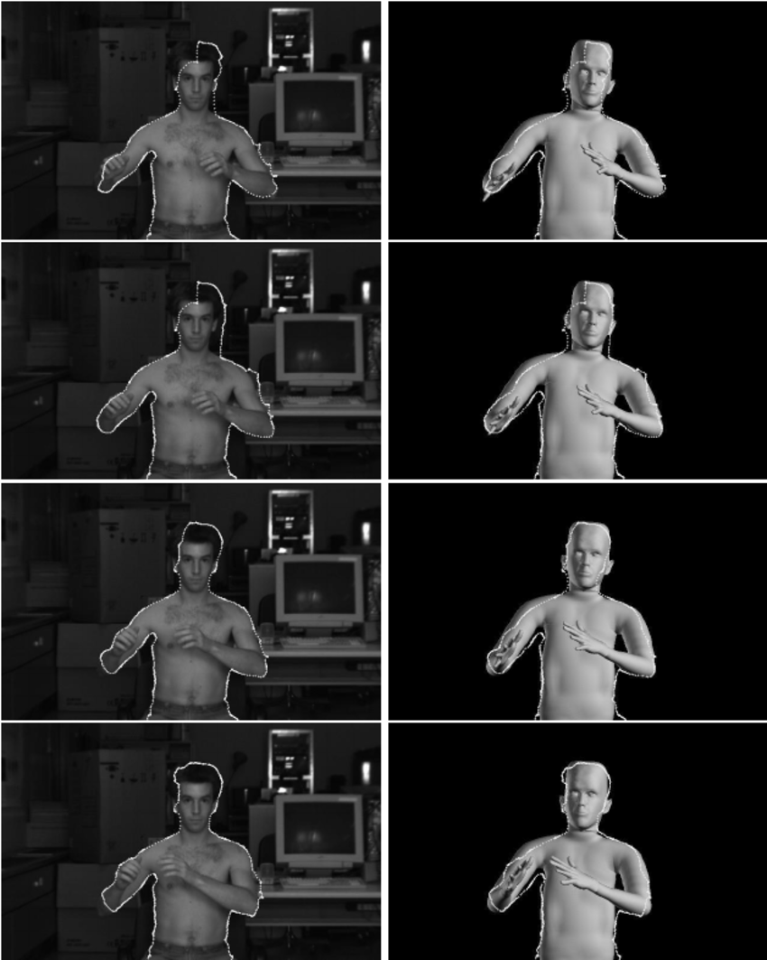
The Approach
Silhouette Tracking:
Tracking results using the model-based silhouette extraction method of Section 4.3. Frames 97, 98, 99 and 100 of the sequence in Figure 3 are shown.
Snake- optimized contours are overlaid on the original images on the left as well as the resulting model on the right

Slide 13
Object tracking levels
Type 1: Single Object Tracking (SOT)
It creates bounding boxes that are given to the tracker based on the first frame of the input image.
Single Object Tracking is also sometimes known as Visual Object Tracking.
SOT implies that one singular object is tracked, even in environments involving other objects.

Slide 14
Object tracking levels
Single Object Tracking (SOT)

Slide 15
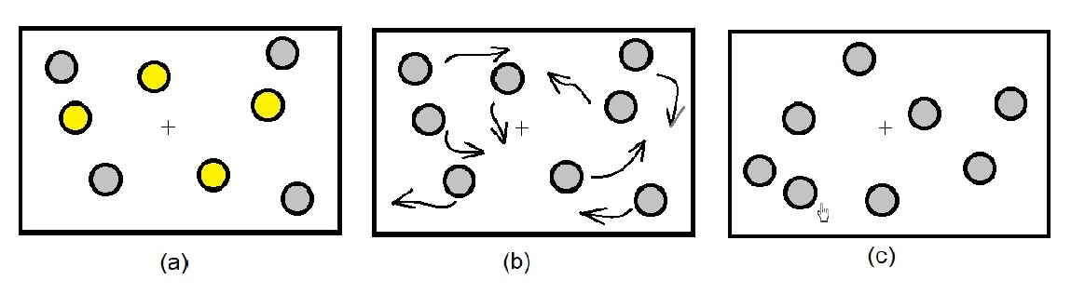
Object tracking levels
Type 2: Multiple Object Tracking, or MOT
It is an experimental technique used to study how our visual system tracks multiple moving objects.

Slide 16
Object tracking levels
Multiple Object Tracking (MOT)

Slide 17
Object tracking Algorithms
OpenCV:
CSRT: is best when the user requires a higher object tracking accuracy and can tolerate slower FPS throughput
KCF tracker: is not as accurate compared to the CSRT but provides comparably higher FPS
The MOSSE tracker is very fast, but its accuracy is even lower than KCF.
DeepSORT: One of the most widely used, object tracking framework is Deep SORT, an extension to SORT (Simple Real time Tracker).
MDNet is fast and accurate, CNN- based visual tracking algorithm inspired by the R-CNN object detection network

Slide 18
Object tracking Algorithms
Optical Flow: Optical flow, or motion estimation, is a fundamental method of calculating the motion of image intensities, which may be ascribed to the motion of objects in the scene.
Meanshift: Mean Shift is a non-parametric iterative algorithm that can be used for a lot of purposes like finding modes, clustering
Kalman Filters: The Kalman filter for tracking moving objects estimates a state vector comprising the parameters of the target, such as position and velocity, based on a dynamic/measurement model

Slide 19
Object tracking
Object tracking is the process of:
Taking an initial set of object detections (such as an input set of bounding box coordinates)
Creating a unique ID for each of the initial detections
And then tracking each of the objects as they move around frames in a video, maintaining the assignment of unique IDs

Slide 20
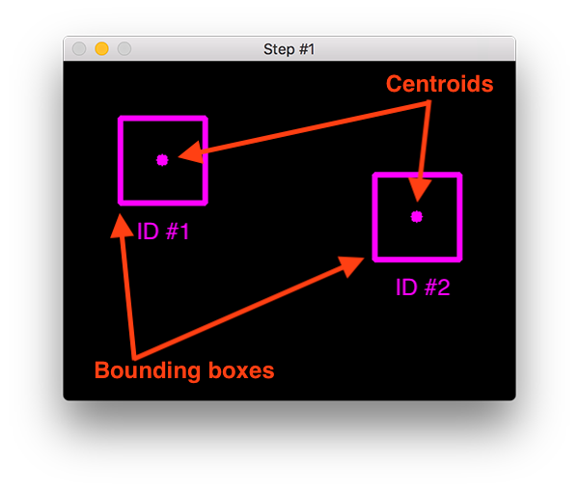
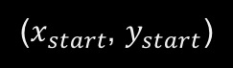

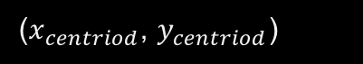

The centroid tracking algorithm
Tracking object
+ Step 1: Compute centroids from box coordinates
($x_{centriod}$, $y_{centriod}$) $=(\frac{x_{end}−x_{start}}{2}$,$\frac{y_{start}−y_{end}}{2})$
($x_{start}$, $y_{start}$)
($x_{centriod}$, $y_{centriod}$)
($x_{end}$, $y_{end}$)
20

Slide 21
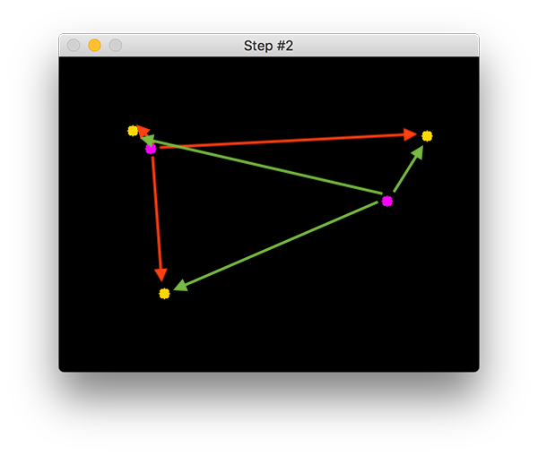


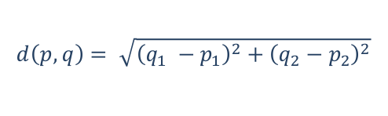
The centroid tracking algorithm
Tracking object
+ Step 1: Compute centroids from box coordinates
($x_{centriod}$, $y_{centriod}$) $=(\frac{x_{end}−x_{start}}{2}$,$\frac{y_{start}−y_{end}}{2})$
+ Step 2: Compute distance between new and existing objects
Euclidean formula: 2 point $p\left(p_{1}, p_{2}\right), q\left(q_{1}, q_{2}\right)$
$$d\left(p,q\right)= \sqrt{{\left(q_{1} −p_{1}\right)}^{2}+{\left(q_{2}−p_{2}\right)}^{2}}$$
21

Slide 22
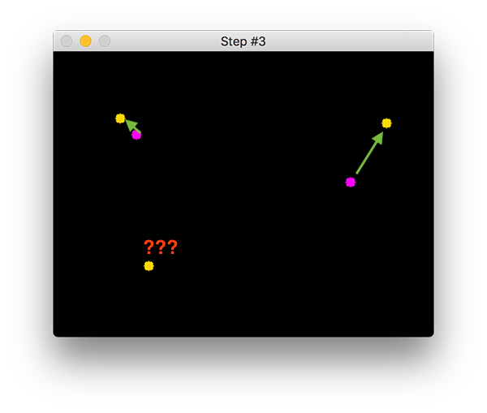
The centroid tracking algorithm
Tracking object
+ Step 1: Compute centroids from box coordinates
($x_{centriod}$, $y_{centriod}$) $=(\frac{x_{end}−x_{start}}{2}$,$\frac{y_{start}−y_{end}}{2})$
+ Step 2: Compute distance between new and existing objects
Euclidean formula: 2 point $p\left(p_{1}, p_{2}\right), q\left(q_{1}, q_{2}\right)$
$$d\left(p,q\right)= \sqrt{{\left(q_{1} −p_{1}\right)}^{2}+{\left(q_{2}−p_{2}\right)}^{2}}$$
+ Step 3: Update (x, y)-coordinates of existing objects
22

Slide 23
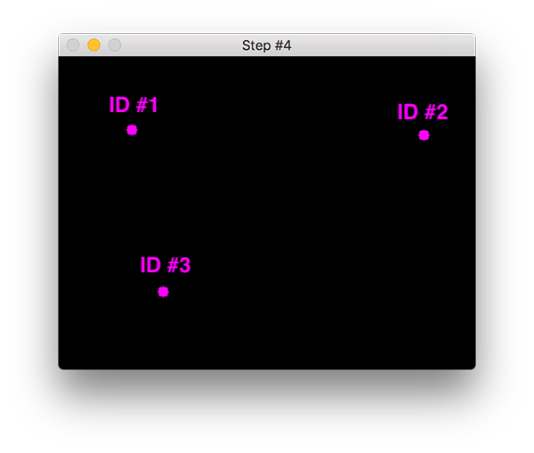
The centroid tracking algorithm
Tracking object
+ Step 1: Compute centroids from box coordinates
($x_{centriod}$, $y_{centriod}$) $=(\frac{x_{end}−x_{start}}{2}$,$\frac{y_{start}−y_{end}}{2})$
+ Step 2: Compute distance between new and existing objects
Euclidean formula: 2 point $p\left(p_{1}, p_{2}\right), q\left(q_{1}, q_{2}\right)$
$$d\left(p,q\right)= \sqrt{{\left(q_{1} −p_{1}\right)}^{2}+{\left(q_{2}−p_{2}\right)}^{2}}$$
+ Step 3: Update (x, y)-coordinates of existing objects
+ Step 4: Register new objects
23

Slide 24
The centroid tracking algorithm
Tracking object
+ Step 1: Compute centroids from box coordinates
($x_{centriod}$, $y_{centriod}$) $=(\frac{x_{end}−x_{start}}{2}$,$\frac{y_{start}−y_{end}}{2})$
+ Step 2: Compute distance between new and existing objects
Euclidean formula: 2 point $p\left(p_{1}, p_{2}\right), q\left(q_{1}, q_{2}\right)$
$$d\left(p,q\right)= \sqrt{{\left(q_{1} −p_{1}\right)}^{2}+{\left(q_{2}−p_{2}\right)}^{2}}$$
+ Step 3: Update (x, y)-coordinates of existing objects
+ Step 4: Register new objects
+ Step 5: Deregister old objects
24

Slide 25
Multiple Object Tracking
Step 1: Create a Single Object Tracker
A multi-object tracker is simply a collection of single object trackers.
Step 2: Read First Frame of a Video
A multi-object tracker requires two inputs
A video frame
Location (bounding boxes) of all objects we want to track.
Given this information, the tracker tracks the location of these specified objects in all subsequent frames.
Step 3: Locate Objects in the First Frame
Next, we need to locate objects we want to track in the first frame. The location is simply a bounding box.

Slide 26
Multiple Object Tracking
Step 4: Initialize the MultiTracker
Until now, we have read the first frame and obtained bounding boxes around objects. That is all the information we need to initialize the multi-object tracker.
Step 5: Update MultiTracker & Display Results
Finally, our MultiTracker is ready and we can track multiple objects in a new frame. We use the update method of the MultiTracker class to locate the objects in a new frame. Each bounding box for each tracked object is drawn using a different color.

Slide 27
Applications
Behavioral analysis of objects or human, such as gesture analysis, facial expression analysis.
Robotics such as autonomous vehicle
Smart camera such as video surveillance

Slide 28
Object tracking challenges
Occlusion: It occurs when an object we are tracking is hidden by another object.
Scale change
Background clutter: Background near object has similar color or texture as the object.
Appearance change: Different viewpoints of an object may look very different visually and without context.
➔ The main challenge is to hold balance between computational efficiency and performance.
Notes:
Like two persons walking past each other, or a car that drives under a bridge. The problem in this case is what you do when an object disappears and reappears again.

Slide 29
Summary
What is Object Tracking?
The techniques used in Object Tracking.
What is a future of object tracking?
Applications of Object tracking

